Slide 1

Learning Objective
I will review Integers.
Enter quietly, please be ready with the following on your desk:
Whiteboard
Whiteboard marker
Exercise Book
Pencil, pen, ruler and red pen
Diary
Calculator
Device – charged or borrowed from Library before maths

Slide 2
Relevant Topics
Lowest Common Multiple - PPT 11
Highest Common Factor - PPT 12
Primes and Composites - PPT 13
Factor Trees - PPT 14
Comparing and Ordering Integers - PP15
Adding and Subtracting Positive Integers - PPT 16
Adding and Subtracting Negative Integers - PPT 17

Slide 3
LOWEST COMMON MULTIPLE

Slide 4
Concept Development
The Lowest Common Multiple (LCM) of two numbers is the lowest number that appears in all of the numbers’ times tables.
Lowest Common Multiple of 3 and 5
Write out the times tables of the first number.
3
6
9
12
15
18
21
24
27
30
5
10
15
20
25
30
35
40
45
50
Write out the times tables of the second number.
The LCM of 3 and 5 is 15.
Highlight the first common number between the lists.
Clearly write out your answer.

Slide 5
Skill Development
CFU
How many answers will you get for LCM?
The Lowest Common Multiple (LCM) of two numbers is the lowest number that appears in all of the numbers’ times tables.
Write out the times tables of the first number.
Lowest Common Multiple of 2 and 4
Write out the times tables of the second number.
2
4
6
8
10
12
4
8
12
16
20
24
The LCM of 2 and 4 is 4.
Highlight the first common number between the lists.
Clearly write out your answer.

Slide 6
Skill Development
CFU
How many answers will you get for LCM?
The Lowest Common Multiple (LCM) of two numbers is the lowest number that appears in all of the numbers’ times tables.
Write out the times tables of the first number.
Lowest Common Multiple of 4 and 6
Write out the times tables of the second number.
4
8
12
16
20
24
6
12
18
24
30
36
The LCM of 4 and 6 is 12.
Highlight the first common number between the lists.
Clearly write out your answer.

Slide 7
HIGHEST COMMON FACTOR

Slide 8
Skill Development
It is often useful to find the highest common factor (HCF) of a pair of numbers. This is also known as the greatest common devisor (GCD).
Write out the factors of the first number.
Highest Common Factor of 12 and 18
1
2
3
4
6
12
1
2
3
6
9
18
Write out the factors of the second number.
Highlight the largest number in common between the lists.
Clearly write out your answer.
The highest common factor of 12 and 18 is 6.

Slide 9
Guided Practice
Whiteboards
Find the factors of:
Find the HCF of:
16
18
28
15 and 12
18 and 24
32 and 24
1, 2, 4, 8, 16
3
1, 2, 3, 6, 9, 18
6
1, 2, 4, 7, 14, 28
8

Slide 10
PRIMES AND COMPOSITES

Slide 11
Skill Development
CFU
How do you decide if a number is composite or prime?
To find if a number is composite or prime:
6
20
Write out the factors of the number.
1, 2, 3, 6
1, 2, 4, 5, 10, 20
There are 4 factors,
There are 6 factors,
therefore 6 is a composite number.
therefore 20 is a composite number.
Count how many factors there are.
2 Factors = Prime
>2 Factors = Composite
23
21
1, 23
1, 3, 7, 21
There are 2 factors,
There are 4 factors,
therefore 23 is a prime number.
therefore 21 is a composite number.

Slide 12
Skill Development
CFU
How do you decide if a number is composite or prime?
To find if a number is composite or prime:
10
11
Write out the factors of the number.
1, 2, 5, 10
1, 11
There are 4 factors,
There are 2 factors,
therefore 10 is a composite number.
therefore 11 is a prime number.
Count how many factors there are.
2 Factors = Prime
>2 Factors = Composite
12
13
1, 2, 3, 4, 6, 12
1, 13
There are 6 factors,
There are 2 factors,
therefore 12 is a composite number.
therefore 13 is a composite number.

Slide 13
Question
Which of the following are prime numbers?
A: 12
B: 23
C: 30
D: 33
E: 61
F: 95

Slide 14
FACTOR TREES

Slide 15

Skill Development
HINT
Use the divisibility laws and count your way up.
e.g. Is it divisible by 2? By 3? By 4?…
To create a factor tree:
18
Start with the original number at the top of the page.
Draw two ‘branches’ down the page.
Write any factor pair at the end of the branches.
Circle any prime numbers.
3
6
Draw more branches for composite numbers.
Write down your factors.
2
3
Circle any prime numbers.
18 = 3 x 3 x 2 = 3³ x 2

Slide 16
Skill Development
HINT
Whiteboards
Use the divisibility laws and count your way up.
e.g. Is it divisible by 2? By 3? By 4?…
There are often many different ways to draw a factor tree of the same number.
24
24
24
12
2
4
6
3
8
2
3
6
2
2
2
2
4
24 = 2³ x 3
3
2
2
2

Slide 17
COMPARING AND ORDERING INTEGERS

Slide 18

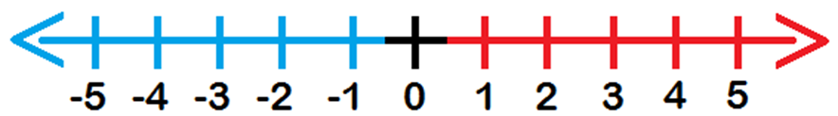
Guided Practice
HINT
The greedy crocodile always eats the bigger number
Sentence Structure
____ is greater than ___.
Which is bigger?
0 or 5
2 or -3
-1 or 1
-5 or -4
0 < 5
2 > -3
-1 < 1
-5 < -4
Whiteboards
28 or 26
111 or -222
-962 or -847
-472 or 389

Slide 19

Skill Development
VOCABULARY
Ascending means to order from smallest to largest.
Descending means to order from largest to smallest.
Put these integers in ascending order.
3, -2, 5, 8, -3 -1, 4, 6, -6, -9, 7
Put these integers in descending order.
7, -5, 8, -2, -1, 3, 5 2, -6, -5, -7, 1, 0, 5, -1
Whiteboards
-3, -2, 3, 5, 8
Whiteboards
8, 7, 5, 3, -1, -2, -5

Slide 20
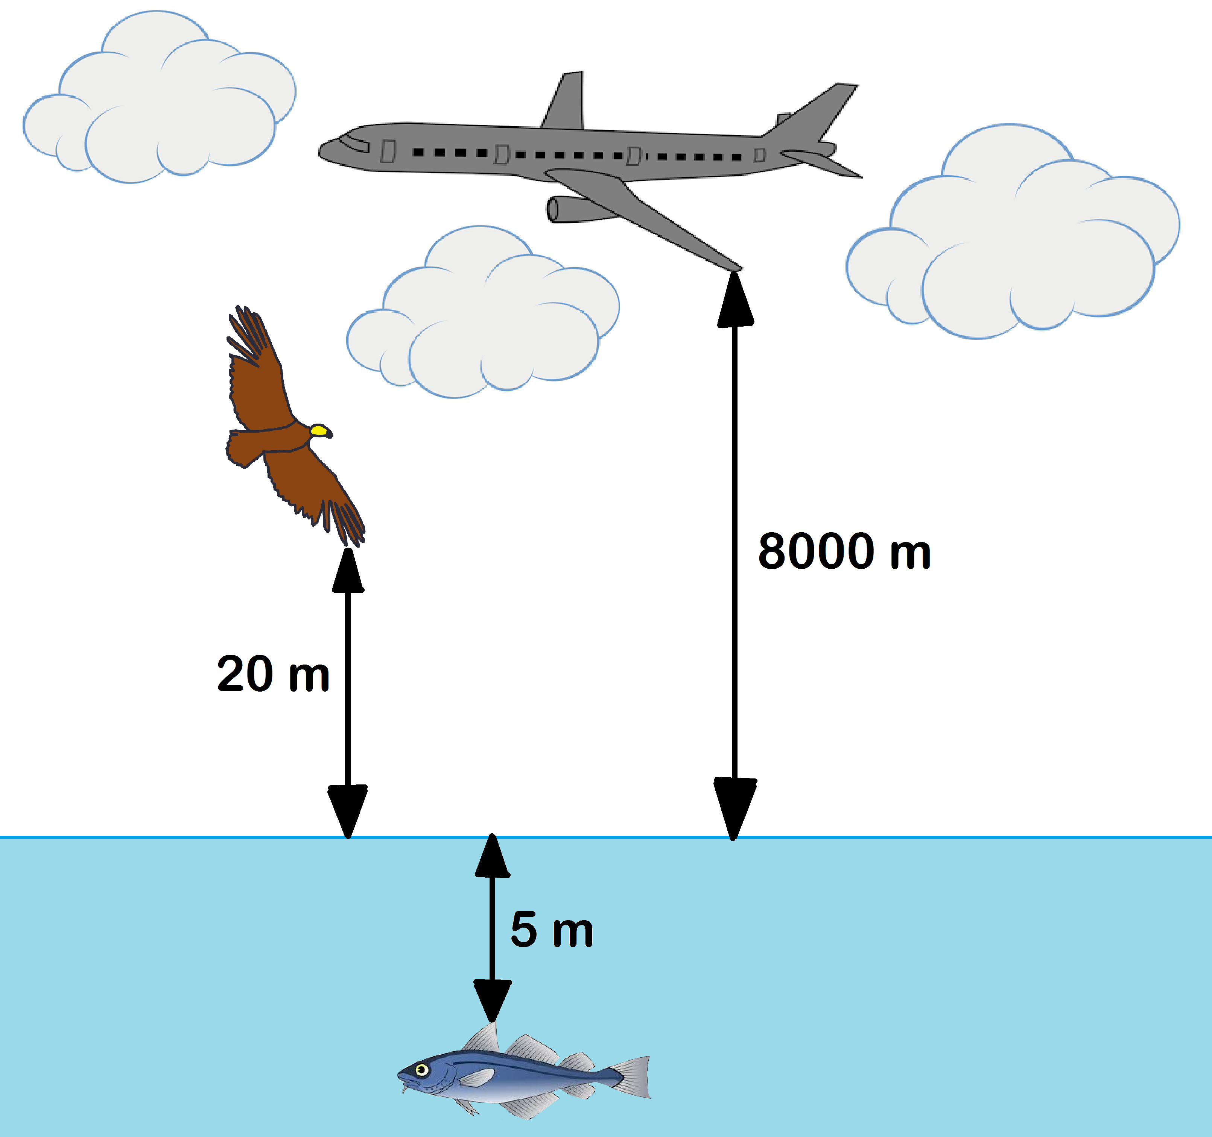
Daily Review
CFU
How would you represent the fish’s position as an integer?
-5
CFU
How far is the bird from the fish?
20 + 5 = 25 m
CFU
What is the distance between the plane and the bird?
8 000 - 20 = 7 980 m
CFU
How far apart are the plane and the fish?
8 000 + 5 = 8 005 m

Slide 21
ADDING AND SUBTRACTING POSITIVE INTEGERS

Slide 22

Concept/Skill Development
HINT
Subtracting means moving left. ←
Adding means moving right. →
Another way:
Think of it like tug of war around zero.
-2 - 6
There are 2 people on the negative side.
= -8
There are 6 more people on the negative side.
Will the answer be positive or negative?
Using the column stacking method,
put the large number on top.
Negative
6
+ 2
8

Slide 23
Concept/Skill Development
HINT
Subtracting means moving left. ←
Adding means moving right. →
Another way:
Think of it like tug of war around zero.
-8 - 8
There are 8 people on the negative side.
= -16
There are 8 more people on the negative side.
Will the answer be positive or negative?
Using the column stacking method,
put the large number on top.
Negative
8
+ 8
16

Slide 24
Guided Practice
HINT
Subtracting means moving left. ←
Adding means moving right. →
Whiteboards
4 + 9
17 - 8
-2 + 9
8 - 12
-41 + 14
16 - 21
-50 - 12
-64 - 81
Will the answer be positive or negative?
Using the column stacking method,
put the large number on top.

Slide 25
ADDING AND SUBTRACTING NEGATIVE INTEGERS

Slide 26
Adding and Subtracting Negative Integers
Concept/Skill Development
(+2) - (-3)
Start here
Face this direction
‘+’ means move FORWARDS,
‘-’ means move BACKWARDS

Slide 27
Adding and Subtracting Negative Integers
Concept/Skill Development
(-1) + (-4)
Start here
Face this direction
‘+’ means move FORWARDS,
‘-’ means move BACKWARDS

Slide 28
Adding and Subtracting Negative Integers
Concept/Skill Development
(0) - (+3)
Start here
Face this direction
‘+’ means move FORWARDS,
‘-’ means move BACKWARDS

Slide 29
Guided Practice
HINT
Subtracting means moving left. ←
Adding means moving right. →
Whiteboards
4 – (-9)
(-17) – (-8)
(-2) + (-9)
8 – (-12)
(-41) + (-14)
16 – (-21)
(-50) – (-12)
(-64) – (-81)
Will the answer be positive or negative?
Using the column stacking method,
put the large number on top.

Slide 30


Independent Practice
Mathematics Page Layout
Open your textbooks to:
Chapter 2 Review
Questions: 1 – 3, 5, 7, 10 – 14

